Slide 1
Designing your writing

Slide 2
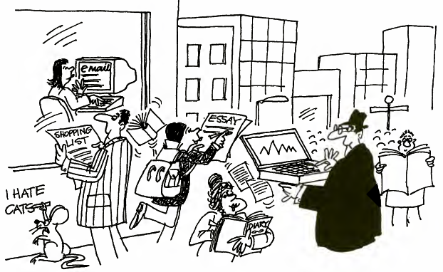
Understanding Process Writing

Slide 3
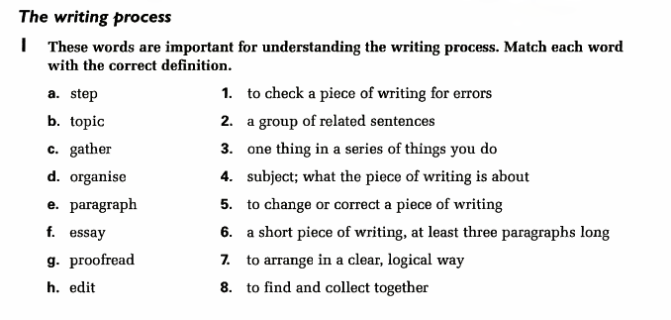

Slide 4
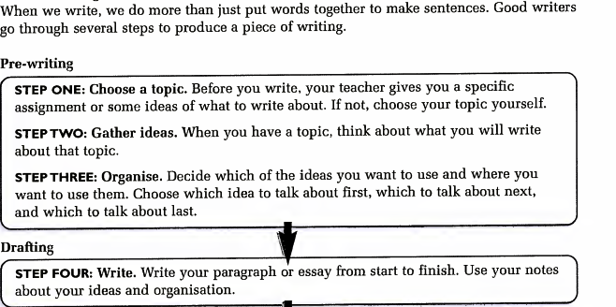

Slide 5
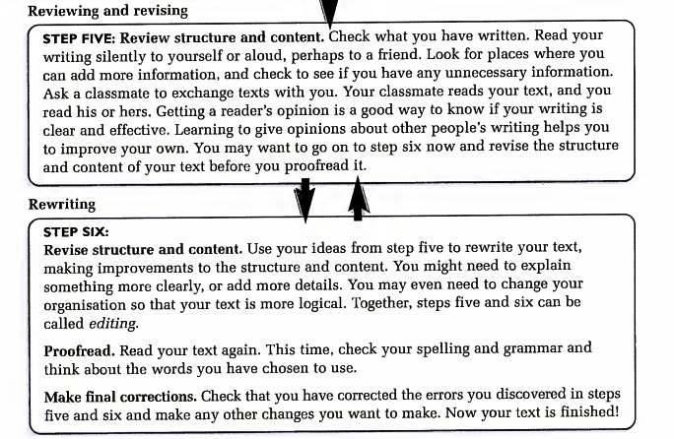

Slide 6
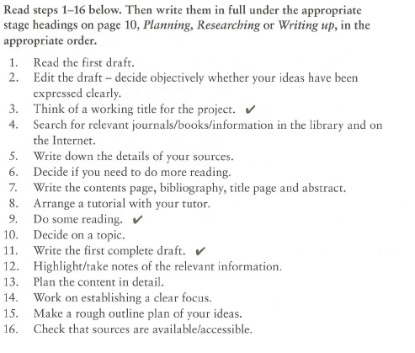

Slide 7
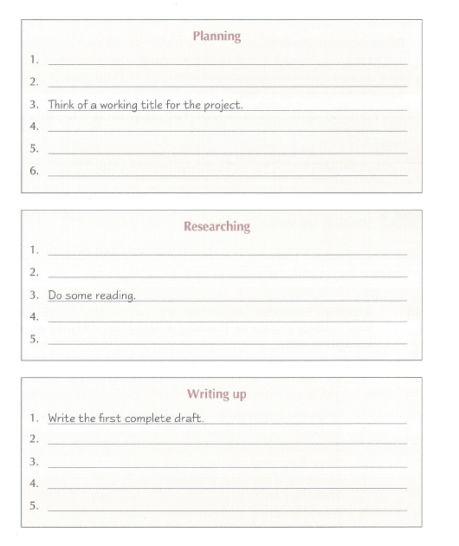

Slide 8
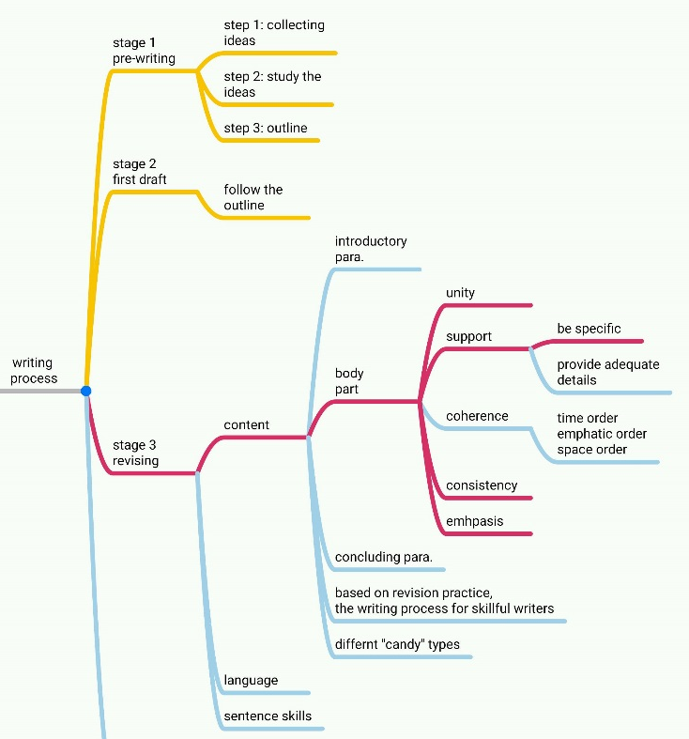

Slide 9
Discussion
What do you find most challenging when you write academic papers?

Slide 10
Structuring your writing
Good writing is well organized and well planned. This means knowing before you write what you will say in your introduction and conclusion, what evidence and data you will showcase, and what examples and devices you will deploy.

Slide 11
First, let’s consider what to include. What are all the possible sections in a piece of academic writing? List them below.
1.
2.
3.
4.
5.
6.
7.
8.
What is the most logical way to order these sections?

Slide 12
Introduction

Slide 13
Body

Slide 14
Conclusion

Slide 15
General structure of an academic paper
Items | Main functions
Title | Summarizing the main text of the paper Attracting readers
Abstract | Explaining the background, topic, approach, conclusion, and significance Summarizing the paper Orienting readers to the paper
Keywords or indexing terms | Highlighting the focus using noun terms
Introduction | Introducing the research background Making a research orientation Stating the research purpose
Literature Review | Reviewing the previous research
Research Methodologies and Procedures | Specifying the methods and procedures used in the study Explaining the theoretical framework or models and the search design Clarifying data collection and treatment, and experimental apparatus and procedures

Slide 16
Items | Main functions
Results and Findings | Summarizing the main results and findings Interpreting or commenting on the most important results with important figures (shown in graphs, tables and diagrams)
Discussion | Expounding the interrelations between the observed facts and their underlying causes Analyzing the data Comparing the results with previous studies and the original hypothesis Developing the hypothesis and speculations Highlighting the viewpoints Mentioning the limitations of the study
Conclusion | Summarizing the main points of the study Presenting the conclusion Providing implications and suggestions for future work
References | Showing respect for previous work Facilitating the literature search

Slide 17
What are the advantages of using this structure? What are the disadvantages?
How could you change this structure?
What structure is common in your discipline?

Slide 18
IMRAD structure
Guess what each letter stands for? Fill in the cart below.
 | What is the section heading? | What content is included in this section?
I
M
R
AND
D

Slide 19
SPRE
Situation–Problem–Response–Evaluation (S-P-R-E) pattern

Slide 20
Example 1
Essay title: By comparing Beijing to other cities around the world, discuss the extent to which Beijing has addressed the need for green space in the city.
Questions: To what extent has Beijing successfully incorporated green space in the city? What other city’s have done so? E.g. New York City?
Possible answer: It’s made some improvements…but it could do more, especially when you look at the example of New York city!

Slide 21
Which of the thesis statements below a, b, or c is more effective? Why? Could you think of a more effective one if you don’t like any of them?
a. Beijing has made excellent progress in greening the city.
b. Beijing is indeed a great example to other cities that wish to create greener urban spaces.
c. Although Beijing has made significant improvements in the greening of the city, much can be learned from policy developments in other cities such as New York.

Slide 22
What is your thesis statement?

Slide 23
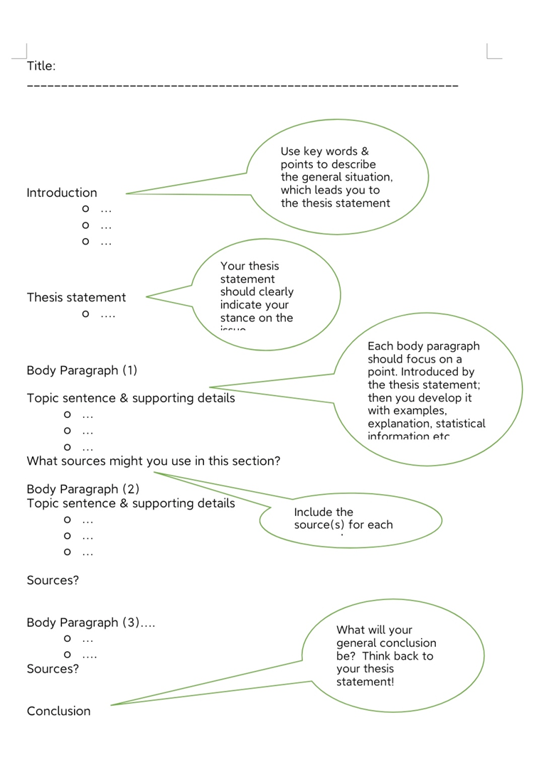

Slide 24
Practice
Find a paper from a major journal in your field and analyze the major parts of the paper and their functions.

